Slide 1
PHYS 7703: Planetary Science
Topic 2: The Earth System
Lecture 4: Atmosphere 3
Disclaimer: Much of the material contained within these lectures is subject to
copyright and is not for distribution or use outside of this course.

Slide 2
Outline of Earth Study
Lecture 1: Interior and Surface.
Lecture 2: Atmosphere Part 1.
Lecture 3: Atmosphere Part 2.
Lecture 4: Atmosphere Part 3.
Lecture 5: Atmosphere Part 4.
Lecture 6: The Moon.
Lecture 7: Atmospheric Evolution Part 1.
Lecture 8: Atmospheric Evolution Part 2.
Lecture 9: Atmospheric Evolution Part 3.

Slide 3
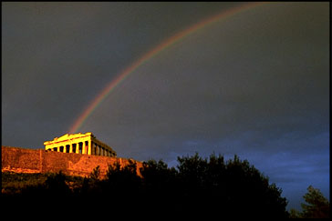
Solar Spectrum
The sun emits radiation at all wavelengths
Most of its energy is in the
IR-VIS-UV
portions of the spectrum
~50% of the energy is in the visible region
~40% in the near-IR
~10% in the UV

Slide 4
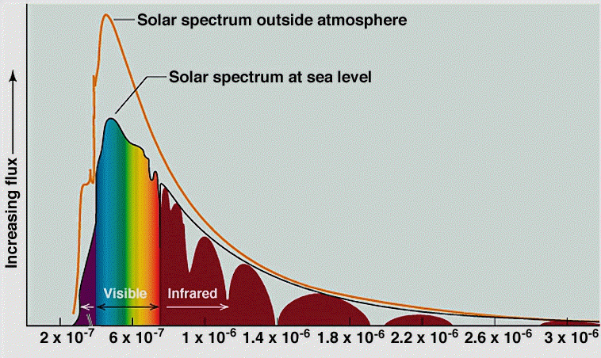
Wavelength (m)

Slide 5
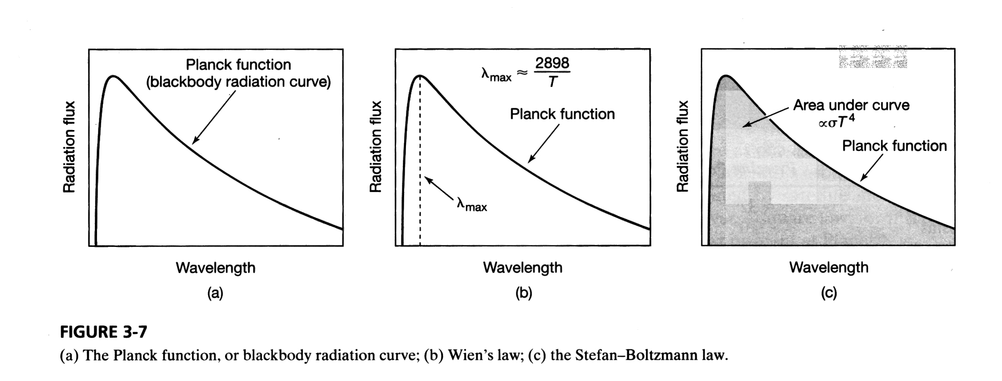


Blackbody Radiation
Planck
function

Slide 6
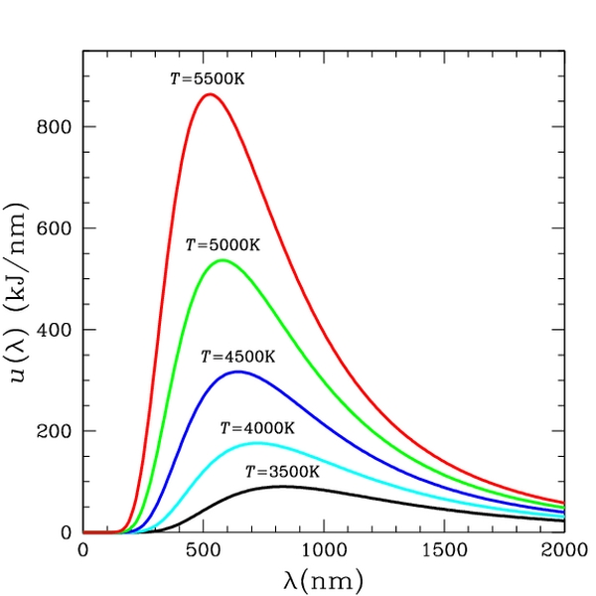
Wikipedia Commons:
http://en.wikipedia.org/wiki/Image:Bbs.jpg

Slide 7
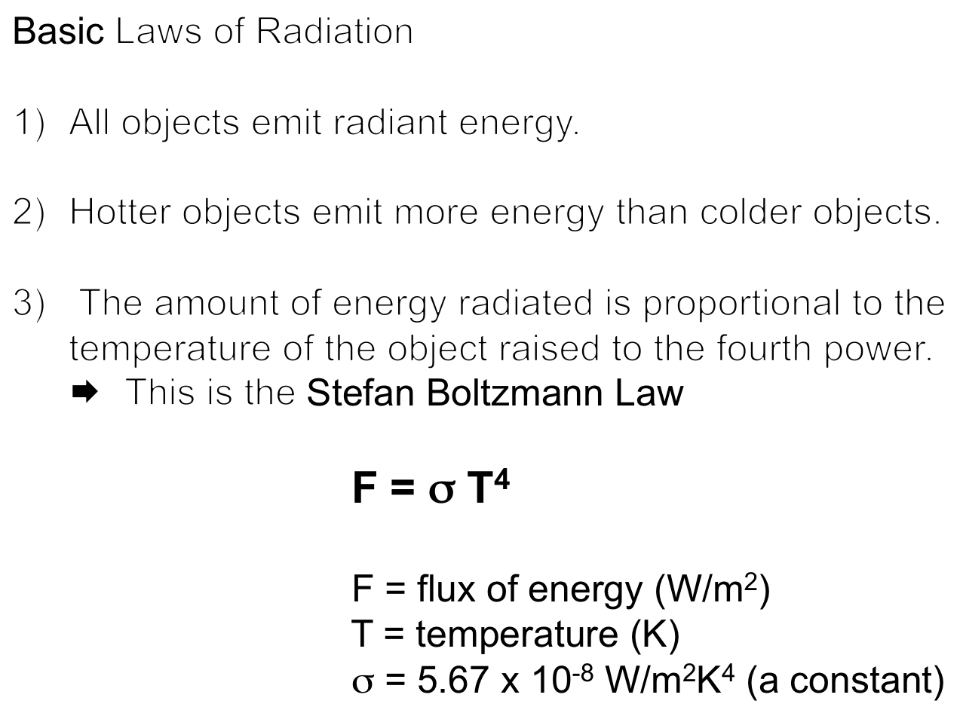

Slide 8
Wikipedia Commons:
http://en.wikipedia.org/wiki/Image:Bbs.jpg

Slide 9
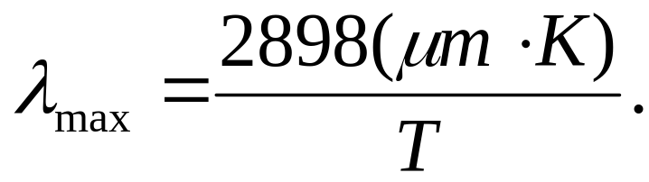
Basic Laws of Radiation
All objects emit radiant energy.
Hotter objects emit more energy than colder objects (per unit area).
The amount of energy radiated is proportional to the temperature of the object.
The hotter the object, the shorter the wavelength (λ) of the peak in emitted energy.
This is Wien’s Law:

Slide 10
Wikipedia Commons:
http://en.wikipedia.org/wiki/Image:Bbs.jpg

Slide 11
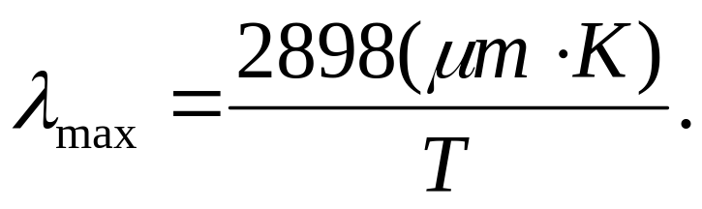
 Stefan-Boltzmann law
F = σ T⁴
F = flux of energy (W/m²)
T = temperature (K)
σ = 5.67 x 10⁻⁸ W/m²K⁴ (a constant)
 Wien’s law

Slide 12

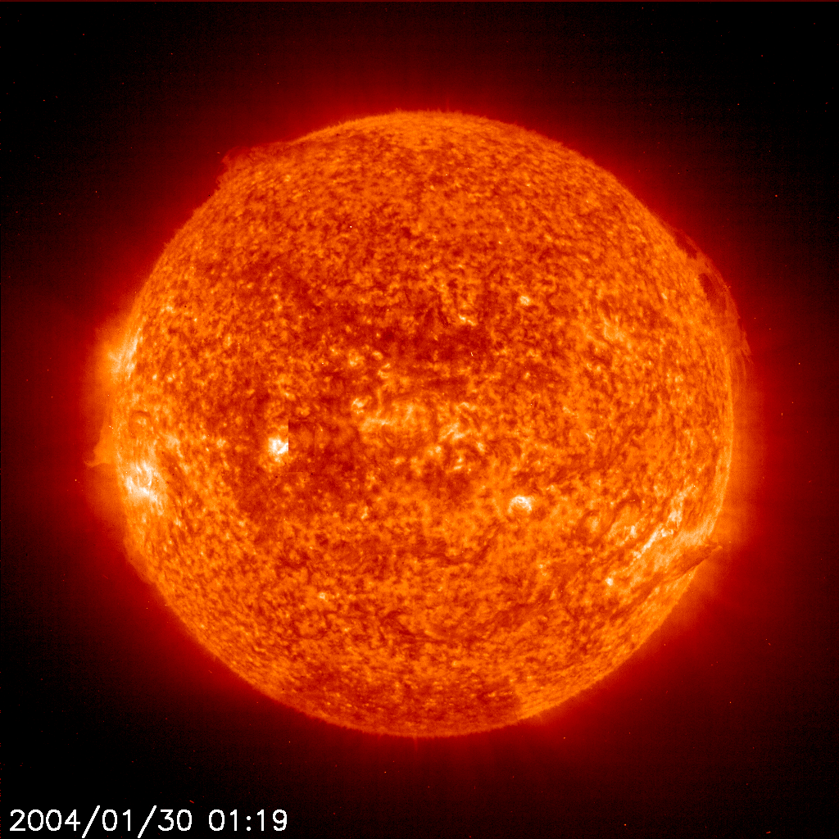
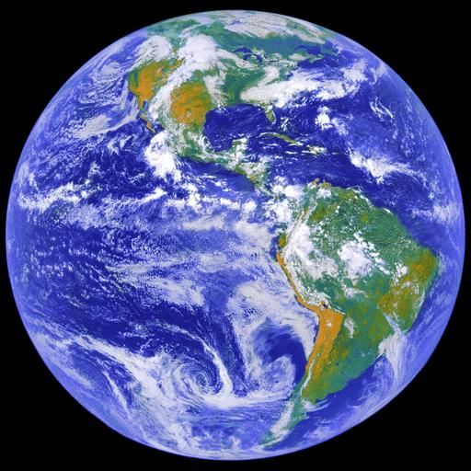
6,000 K
300 K

Slide 13
Electromagnetic Spectrum
visible
light
microwaves
infrared
ultraviolet
x-rays
1000
100
10
1
0.1
0.01
Low
Energy
High
Energy
λ (μm)

Slide 14
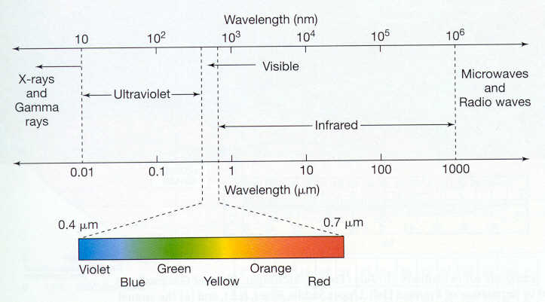
Blue light from the Sun is removed from the beam
by Rayleigh scattering, so the Sun appears yellow
when viewed from Earth’s surface even though its
radiation peaks in the green

Slide 15
 Stefan-Boltzman law
F = σ T⁴
F = flux of energy (W/m²)
T = temperature (K)
σ = 5.67 x 10⁻⁸ W/m²/K⁴ (a constant)

Slide 16
 | T (K) | λ_{max} (μm) | region in spectrum | F (W/m²)
Sun | 6000 | 0.5 | Visible (green) | 7 x 10⁷
Earth | 300 | 10 | infrared | 460

Slide 17
Solar Radiation and Earth’s Energy Balance

Slide 18
Planetary Energy Balance
We can use the concepts learned so far to calculate the radiation balance of the Earth

Slide 19
Energy Balance:
The amount of energy delivered to the Earth is equal to the energy lost from the Earth.
Otherwise, the Earth’s temperature would continually rise (or fall).

Slide 20
Energy Balance:
Incoming energy = outgoing energy
E_{in} = E_{out}
E_{out}
E_{in}

Slide 21
How much solar energy reaches the Earth?
As energy moves away from the sun, it is spread over a greater and greater area.
 This is the Inverse Square Law

Slide 22
Define S_{o} as the energy flux reaching the Earth from the Sun.
We can calculate S_{o}:
S_{o} = L / A,
where L = The Sun’s luminosity
and A = area of a sphere with a radius equal to Earth’s orbital distance

Slide 23
S_{o} is the solar constant for Earth
It is determined by the distance between Earth (r_{s-e}) and the Sun and the Sun’ luminosity.

Slide 24
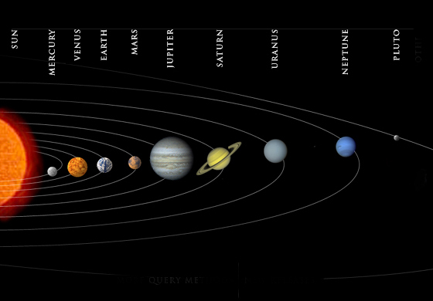
Each planet has its own solar constant…

Slide 25
How much solar energy reaches the Earth?
Assuming solar radiation covers the area of a circle defined by the radius of the Earth (r_{e})
E_{in} = S_{o} (W/m²) x π r_{e}² (m²)
E_{in}
r_{e}

Slide 26
How much solar energy reaches the Earth?
E_{in} = S_{o} π r_{e}²
BUT THIS IS NOT QUITE CORRECT!
**Some energy is reflected away**
E_{in}
r_{e}

Slide 27
How much solar energy reaches the Earth?
Albedo (A) = % energy reflected away
E_{in} = S_{o} π r_{e}² (1-A)
E_{in}
r_{e}

Slide 28
How much solar energy reaches the Earth?
Albedo (A) = % energy reflected away
A= 0.3 today
E_{in} = S_{o} π r_{e}² (1-A)
E_{in} = S_{o} π r_{e}² (0.7)
E_{in}
r_{e}

Slide 29
How much energy does the Earth emit?
300 K

Slide 30
How much energy does the Earth emit?
E_{out} = F x (area of the Earth)
F = σ T⁴
Area = 4 π r_{e}²
E_{out} = (σ T⁴) x (4 π r_{e}²)

Slide 31
Hotter objects emit at shorter wavelengths.
λ_{max} = 3000/T
Sun
Earth
1000
100
10
1
0.1
0.01
Hotter objects emit more energy than colder objects
F = σ T⁴
λ (μm)

Slide 32
Energy Balance:
E_{in} = E_{out}
E_{in} = S_{o} π r_{e}² (1-A)
E_{out} = σ T⁴(4 π r_{e}²)
E_{out}
E_{in}

Slide 33
Energy Balance:
E_{in} = E_{out}
S_{o} (1-A) = σ T⁴ (4)
T⁴ = S_{o}(1-A)
4σ
E_{out}
E_{in}

Slide 34
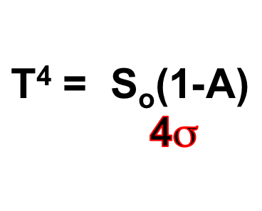
If we know S_{o} and A, we can calculate the temperature of the Earth. We call this the expected temperature (T_{exp}). It is the temperature we would expect if Earth behaves like a blackbody.
This calculation can be done for any planet, provided we know its solar constant and albedo.

Slide 35
T⁴ = S_{o}(1-A)
4σ
For Earth:
S_{o} = 1370 W/m²
A = 0.3
σ = 5.67 x 10⁻⁸
T⁴ = (1370 W/m²)(1-0.3)
4 (5.67 x 10⁻⁸ W/m²K⁴)
T⁴ = 4.23 x 10⁹ (K⁴)
T = 255 K

Slide 36
Expected Temperature:
T_{exp} = 255 K
(ºC) = (K) - 273
So….
T_{exp} = (255 - 273) = -18 ºC
(which is about 0 ºF)

Slide 37
Is the Earth’s surface really -18 ºC?
NO. The actual temperature is warmer!
The observed temperature (T_{obs}) is 15 ºC, or about 59 ºF.
The difference between observed and expected temperatures (ΔT):
      ΔT = T_{obs} - T_{exp}
      ΔT = 15 - (-18)
      ΔT = + 33 ºC

Slide 38
ΔT = + 33 ºC
In other words, the Earth is 33 ºC warmer than expected based on black body calculations and the known input of solar energy.
This extra warmth is what we call the GREENHOUSE EFFECT.
It is a result of warming of the Earth’s surface by the absorption of radiation by molecules in the atmosphere.

Slide 39
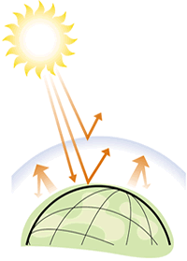
The greenhouse effect:
Heat is absorbed or “trapped” by gases in the atmosphere.
Earth naturally has a greenhouse effect of +33 ºC.

Slide 40
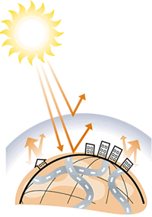
The concern is that the amount of greenhouse warming will increase with the rise of CO₂ due to human activity.

Slide 41
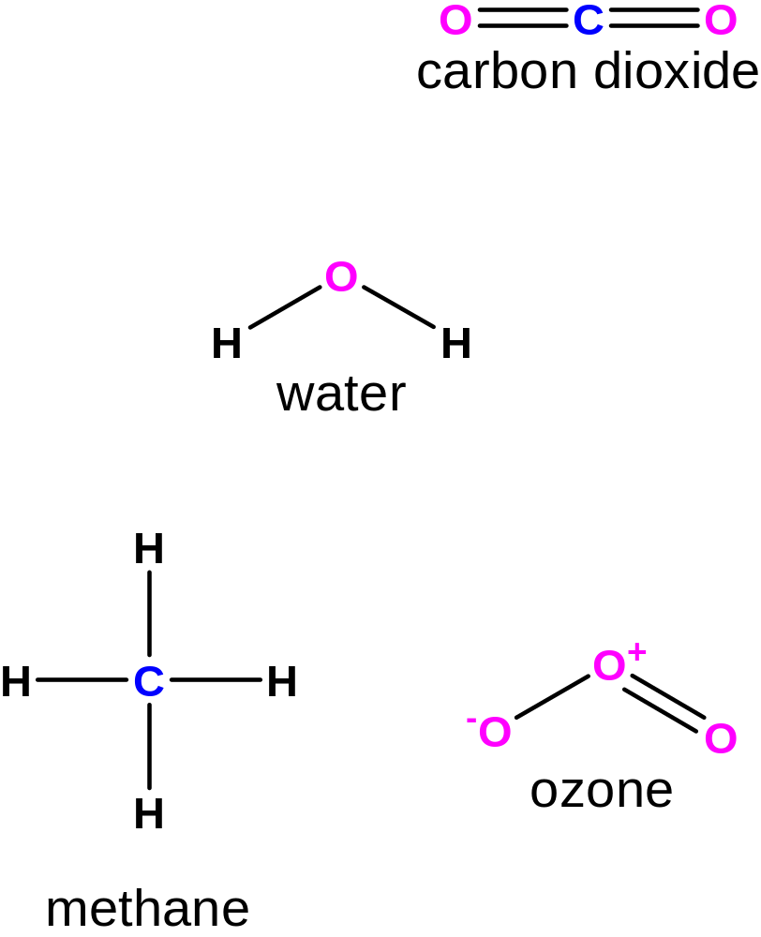
Greenhouse Gases

Slide 42
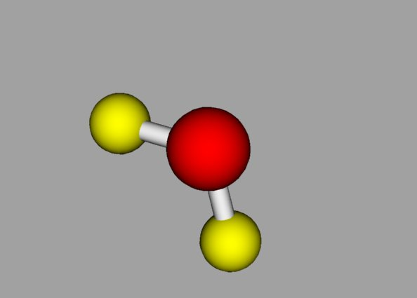
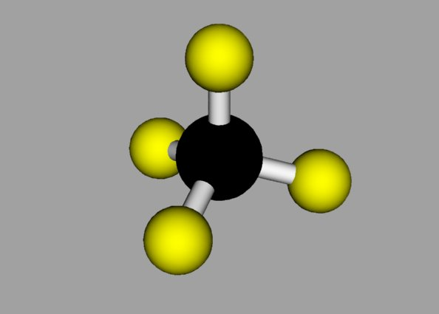
Water
Methane

Slide 43
Non-greenhouse Gases
N₂
O₂
N ≡ N
O = O
What distinguishes these gases from
greenhouse gases?

Slide 44
Non-greenhouse Gases
N ≡ N
O = O
Answer: Symmetry!
(Technically speaking, greenhouse gases
have a dipole moment whereas N₂ and O₂
don’t)

Slide 45
(−)
O
H
H
(+)
Oxygen has an unfilled outer shell
of electrons (6 out of 8), so it wants
to attract additional electrons. It gets
them from the hydrogen atoms.

Slide 46
Molecules with an uneven distribution of electrons are especially good absorbers and emitters.
These molecules are called dipoles.
Water
H
O
H
oxygen is more electronegative than hydrogen

Slide 47
Molecules with an uneven distribution of electrons are especially good absorbers and emitters.
These molecules are called dipoles.
Water
Electron-poor region:
Partial positive charge
H
O
H
oxygen is more electronegative than hydrogen
Electron-rich region:
Partial negative charge

Slide 48
Molecules absorb energy from radiation.
The energy increases the movement of the molecules.
The molecules rotate and vibrate.
stretching
bending
Vibration

Slide 49
Approximate absorption regions
O₂
O₃
H₂O
O₃
CO₂
H₂O
Radiant energy
Sun
Earth
0.1
1.0
10
15
100
λ (μm)

